Slide 1
FDP Expanded Clearinghouse
Lynette Arias, University of Washington
Pamela Webb, University of Minnesota
Jennifer Barron, Johns Hopkins University
Chris Renner, Vanderbilt University Medical Center
FDP Meeting – Jan 2017

Slide 2
Agenda
Brief overview
Cohort 1 & 2 – Reporting Period 2 data results
Phase 2 - Web based system
  Overview
  Demo/Training
  Go-Live estimated timeline
Cohort 3 Go-Live Plans
Financial Questionnaire – for use by non Single Audit Entities
Next Steps

Slide 3
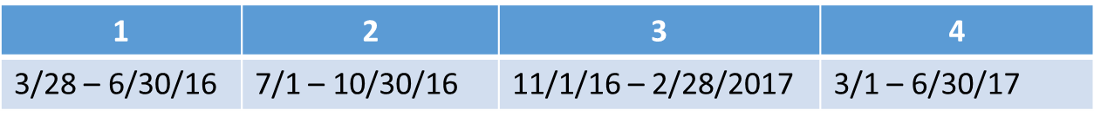
Pilot overview
Pilot timeline - where are we now?
Pilot Period 2/1/2016 – 6/30/2017 (17 months)
# of FDP member institutions involved so far
  79 FDP Members & 127 total individual entities
  Brought into the Pilot in 2 Cohorts (3/28 & 8/18)
Tracking use of clearinghouse in 4 reporting periods
Using basic Excel Profile document in 1st phase of Pilot
Shifting to Piloting use of a web based system in 2017
Plans to add Cohort 3 institutions in March/April 2017
Excel Profiles will be maintained until web system fully up and running

Slide 4

Pilot Estimated Timeline
Phase 1 Proposal approved by FDP Executive Committee
1/10/2016
Official State Date of Pilot
2/1/2016
Estimated End Date of Pilot
Phase 2 - Web Based System Proposal approved by FDP Executive Committee
6/16/2016
6/30/2017
2015
Jan
Apr
Jul
Oct
2016
Apr
Jul
Oct
2017
Apr
2017
1/8/2015
9/1/2015
8/18/2016
Today
3/15/2017
Expanded Clearinghouse Working Group gathers again
Forms Data Collection/Analysis completed
Cohort 2 Go-Live
Cohort 3 Go-Live
(tentative & utilizing web system)
3/28/2016
Cohort 1 Go-Live
12/18/2015
12/2/2016
Entity Profile developed & Beta tested
System user acceptance testing
9/22/2016
Web based system initial dev demo at Sept FDP Meeting
2/15/2017
Cohort 1 & 2 System Go-Live (tentative)

Slide 5
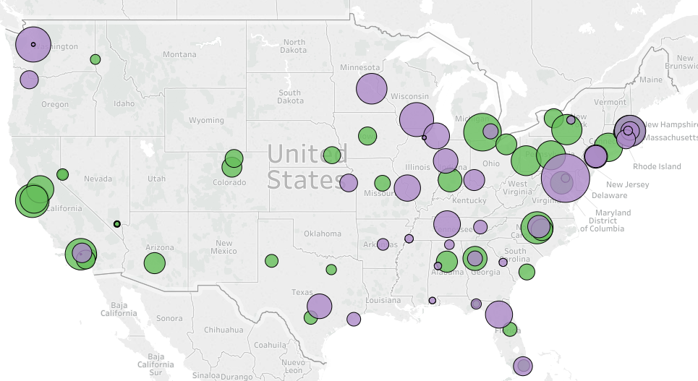

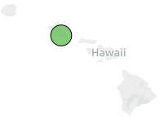
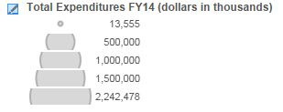
Piloteers – Cohorts 1 & 2

Slide 6
Reporting Period 2 Results
Entity Profiles 127
FDP Members Represented 87
Entities Submitting Reports 118 (93% of total)
Entities With Activity this Period 84 (66% of total)
Some entities reported no activity but issued subs to other Piloteers
May need to do supplemental education with Piloteers about what and how to track/report

Slide 7
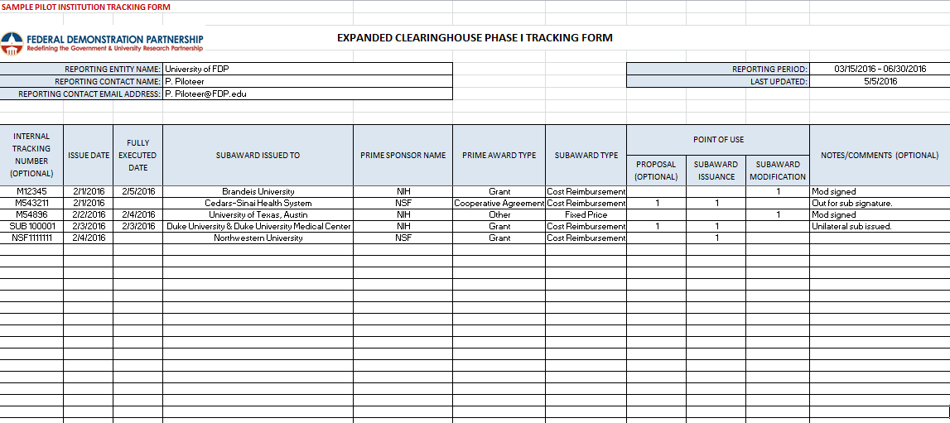
Sample Tracking Form

Slide 8
Subaward Volume & EC Use
51 profiles
Reporting Period 1 (3/28/16 – 6/30/16)
Cohort 1 640 transactions 40% EC used
Reporting Period 2 (7/1/16 – 10/31/16)
Cohort 1 1906 transactions 52% EC used
Cohort 2 1193 transactions 72% EC used
3099 total transactions 60% EC used
Cohort 1 includes 5 large schools that didn’t use commitment forms pre-pilot and don’t use EC profiles during the pilot
127 profiles

Slide 9
Time Saved
Per survey of Cohorts 1 & 2 institutions regarding average time to issue, complete, and review subrecipient commitment forms, estimated time saved per subaward by utilizing an Entity Profile is:
Pass-through Entity: 1.8 hours
Subrecipient Entity 1.3 hours

Slide 10
Time Saved Calculations for Period 2
Cohort | Entity Profile Used as PTE | Entity Profile Used as Sub | Total Hours Saved | Average Hours Saved Per Institution | Average Hours Saved Per Institution Per Day
1 | 986 | 973 | 3,040 | 57.35 | 0.47
2 | 859 | 872 | 2,680 | 36.21 | 0.48
Total Hours Saved = 5,720

Slide 11
Institutions with 5+ Transactions
Cohort | # of Entities | Live Business Days | Entity Profile Used as PTE | Entity Profile Used as Sub | Total Hours Saved | Average Hours Saved Per Institution | Average Hours Saved Per Institution Per Day
1 | 30 | 85 | 968 | 951 | 2,979 | 99.29 | 1.17
2 | 31 | 52 | 831 | 848 | 2,598 | 83.81 | 1.61
Total Hours Saved = 5,570

Slide 12
Institutions with >50 Subawards to Fellow Piloteers in Period 2
Massachusetts General Hospital | 138
Johns Hopkins University | 118
University of Washington | 116
University of California, San Francisco | 113
Duke University | 98
Brigham and Women's Hospital | 90
Washington University | 83
Stanford University | 83
Dana-Farber Cancer Institute | 79
University of Michigan | 73
University of California, Los Angeles | 73
University of North Carolina at Chapel Hill | 69
Vanderbilt University | 61
Massachusetts Institute of Technology | 60
University of Minnesota – Twin Cities | 59
University of Florida | 56
Harvard T.H. Chan School of Public Health | 53
University of Wisconsin-Madison | 51
Yale University | 51

Slide 13
Frequent Pairings & Proximity
Pairs of institutions with most subrecipient activity tended to be in close proximity to each other.
Cities | Subaward Actions
Boston, MA & Boston, MA | 142
Cambridge, MA & Boston, MA | 98
Boston, MA & Cambridge, MA | 94
Baltimore, MD & Baltimore, MD | 33
Chapel Hill, NC & Durham, NC | 27
Nashville, TN & Nashville, TN | 26
New York, NY & New York, NY | 25
Durham, NC & Chapel Hill, NC | 25
Atlanta, GA & Atlanta, GA | 23
Berkeley, CA & San Francisco, CA | 22
18 pairs of institutions recorded five or more actions in both directions, as both pass-through entity and subrecipient.

Slide 14
Sources of Subaward Funding
The U.S. Department of Health & Human Services was the prime sponsor in 66% of the subaward actions recorded.

Slide 15
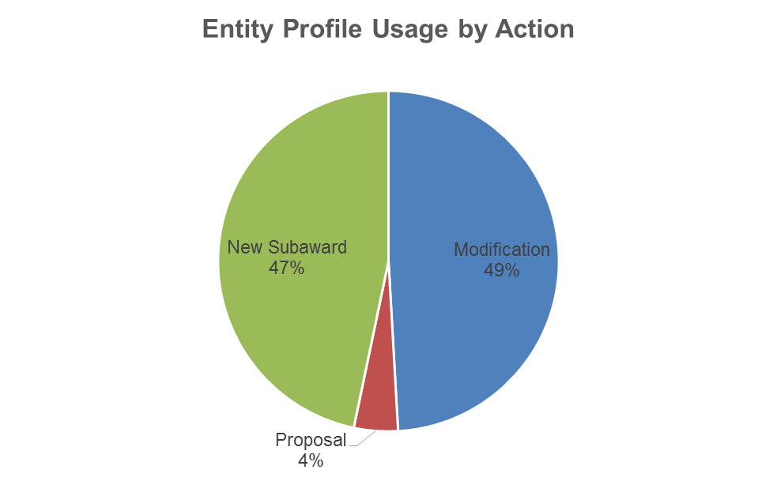
When do most institutions use the EC?

Slide 16
Phase 2 – Web based system
Development active since Sept FDP meeting
Active user acceptance testing – Nov thru Jan
  By Working Group members
Reminders about this phase of development
  Keeping functionality basic
  Same “functionality”/content as Excel Profile
  Brings in basic validations
  When we all go live – will all be testing in Pilot phase still!
  We are doing all we can to help it go smoothly and be very intuitive

Slide 17
Web system - Overview
Basic system first developed
  Data entry forms, with validation and dropdown lists for standard consistent options
  User access management structure
  Workflow and Authorization process
  Users will sign business use agreement
  Simple print function
Future enhancements
  Pull data from other systems, as feasible (SAM)
  Automatic notifications to POC for expired information
  API’s (Application Program Interface)
  Additional reports and data output
Cohort 1 & 2 data into new system
  Had talked about doing a system conversion
  Opting for all Piloteers to enter their information – as part of testing

Slide 18
Web system – Overview of Use
Instructions to be provided at kick off
All Piloteer Primary Points of Contact will be set up as Entity Super User by system developers
  Call for POC updates will be sent after FDP meeting
  Email will be sent to POC/Super User with login in
  POC can then go in and create other users & grant rights
  POC can then create Profile or other user they create can
Once logged in – simply navigate to “Add Organization”
  3 initial fields of data to create a new Profile
  Enter data by tab from there
  When data all added in Profile, editor submits to AO
  AO gets email, reviews, authorizes and submits to FDP
  FDP reviews, approves and publishes (if all is well)

Slide 19
Phase 2 – Web based system Demo/Training
Chris Renner, Vanderbilt University Medical Center

Slide 20
System Go-Live / Cohort 3 Go-Live
Estimated Timeline
Target Date | Action / Activity
1/16/2017 | Call for updates to Piloteer POC’s sent
2/15/2017 | POC’s set up with Super User access – emails sent
 | Go-Live Kick-off email & instructions sent to Piloteers
 | Piloteers begin creating their Profiles in web system
3/1/2017 | Deadline for all web Profiles being submitted to FDP
3/1/2017 | Target date to have all Profiles approved & published
3/15/2017 | Target go-live for Cohort 3 – kick off email sent
3/29/2017 | Deadline for Cohort 3 Profiles being submitted to FDP
4/1/2017 | Target date for all Cohort 3 Profiles to be approved & published for use
6/30/2017 | Final reporting period ends. Pilot officially ends

Slide 21
Financial Questionnaire
Available for Entities NOT subject to Single Audit
Series of questions to help assess Entity overall
Matches very closely with NSF Financial Management Systems Questionnaire:
  General Information
  Fiscal Responsibility and Internal Controls
  Accounting System
  Facilities & Administrative Costs
  Cost Sharing
  Funds Management
  Personnel
  Procurement
  Property Management
  Cost Transfers
  Program Income
Subgroup lead – Sara Clough, sarac@Austin.utexas.edu
Smart Form Under Construction!

Slide 22
Next Steps
Tentative Go live for use of system – 2/15/2017
Pilot reporting periods – gather data on effectiveness of use of Clearinghouse!
Cohort 3 – tentative go live 3/15 /2017 “Volunteers” thus far:
  University of Pittsburgh
  Michigan State University
  Ohio State University
  Other UC schools: Merced, Santa Barbara, Santa Cruz, San Diego
  Northeastern
  Columbia University
  University of Southern California
  University of Iowa
  University of Texas, Arlington
  University of Colorado, Denver
1 | 2 | 3 | 4
3/28 – 6/30/16 | 7/1 – 10/30/16 | 11/1/16 – 2/28/2017 | 3/1 – 6/30/17

Slide 23
Opportunities
Piloteers – please consider adding attachments to your institution web sites ☺
Opportunities to join in the future?
  Not part of Cohort 1 or 2? – gather support at your institution!
    For possible Cohort 3 addition in future
    If institution not interested in joining – why not? Let us know so we can help make changes, if feasible, that would help!
  If all goes well with Pilot and web based system could be recommended for non FDP institutions later in 2017
Keep an eye on what we are up to! ☺
  FDP Expanded Clearinghouse Webpage
    http://sites.nationalacademies.org/PGA/fdp/PGA_055835
  Everything we are working on is kept here! We are fully transparent!

Slide 24
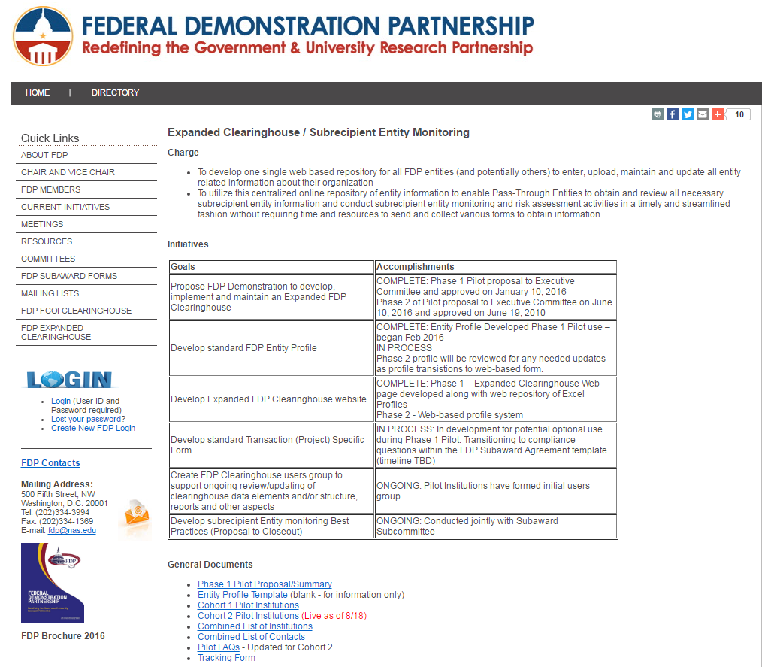
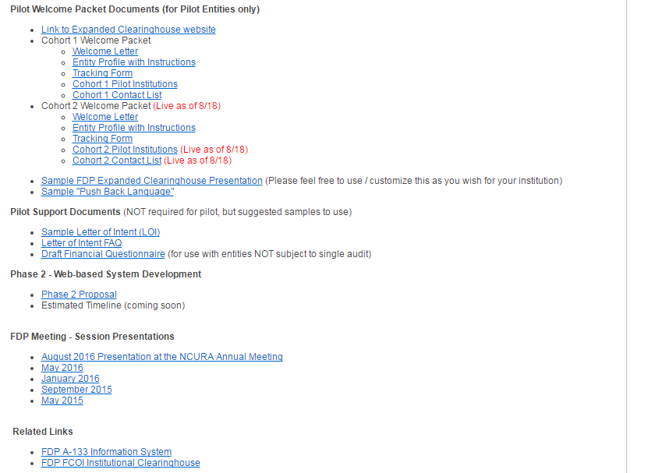
Resources
http://sites.nationalacademies.org/PGA/fdp/PGA_055835

Slide 25
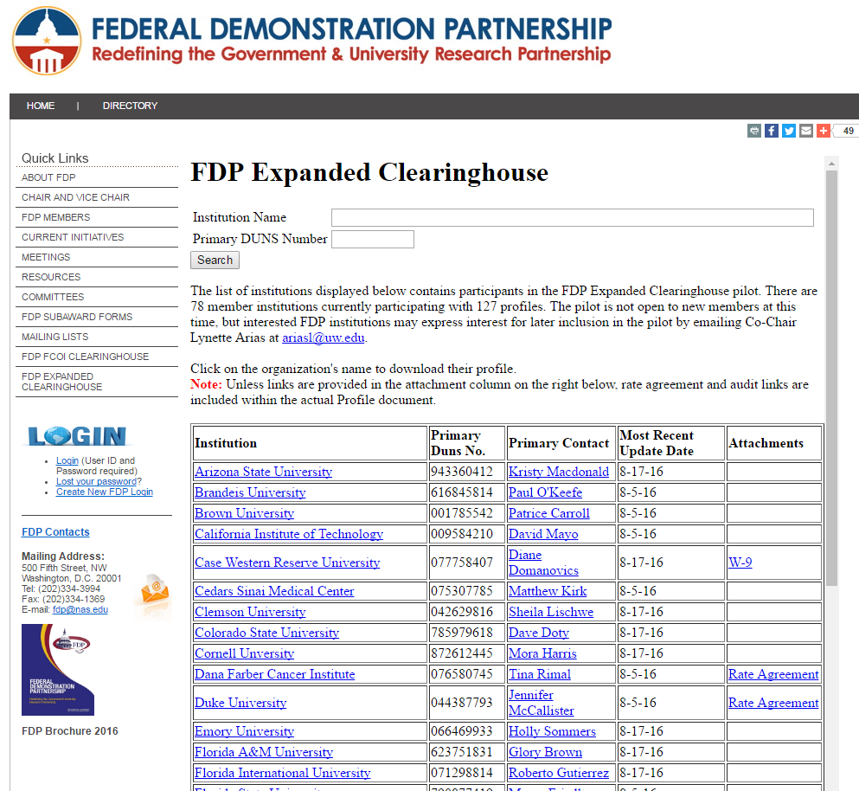

Slide 26


Continued thanks to a Great Team!
WORKGROUP MEMBERS
Lynette Arias (Co-Chair) | University of Washington
Jennifer Barron (Co-Chair) | Johns Hopkins University
Pamela Webb (Co-Chair) | University of Minnesota
Patrice Carroll | Brown University
Marcy Friedle | Florida State University
Rebecca Balentine | Icahn School of Medicine at Mount Sinai
Julie Thatcher | Institute for Systems Biology (ERI)
Amanda Hamaker | Purdue University
Gloria Greene/ Steve Parker | University of Alabama
Jennifer Rodis | University of Wisconsin-Madison
Sara Clough | UT Austin
Courtney Swaney | UT Austin
Robert Prentiss | UT Austin
Tyra Patrice Darville-Layne | Northwestern University
Christopher Renner | Vanderbilt University
Lulu Sun
UW Work study student

Slide 27

Questions & Discussion
All Profile updates and questions, please use
  fdpechelp@gmail.com

Slide 28



Contact Info
Lynette Arias
  University of Washington
  ariasl@uw.edu
Pamela Webb
  University of Minnesota
  pwebb@umn.edu
Jennifer Barron
  Johns Hopkins University
  jlb@jhu.edu

