Slide 1
Conflict of Interest
FDP TRAINING FOR [YOUR ORGANIZATION]:
Organizational Conflict of Interest
May 21, 2019
From the Organizational Conflicts of Interest Working Group

Slide 2
Organizational Conflict of Interest
OCI WORKING GROUP
Mary Lee, Stanford University; Joy Bryde, Univ. North Carolina - Chapel Hill,
Kristy Hall, University of Virginia and Zack Byrnes, University of Pittsburgh.
Working Group participants: University of California, Northeastern University, Vanderbilt University, University of Tennessee, Columbia University, State University of New York, Colorado State University.

Slide 3
Disclaimer
Content provided in this presentation is for general information and educational purposes only. Please consult with your legal and compliance offices to determine the appropriate approach for your university.
Requirements/information in these slides are subject to change per federal regulations or sponsor requirements.

Slide 4
Topics Covered in Overview
COI Types
  Individual
  Institutional
  Organizational
Organizational COI (OCI)
OCI Procurements and Subcontracts
OCI Certification Processes
Conclusions
Resources

Slide 5
3 Types of Research Related COI
Type | Description | Regulations?
Individual | Research Bias: Individual’s outside financial interests may bias research. Procurement COI: When individual spends university’s funds on vendor related to individual. | Numerous federal regulations.
Institutional | Institution is the “person” with a conflict When Institutional Leader has outside financial interest related to University research and is in a position to influence the research or spend university funds for personal gain. When Institution owns equity, intellectual property interests or could otherwise financially benefit (immediate or future) from influencing research. | No federal definitions or regulations. See AAMC ICOI paper. State institutions subject to state laws.
Organizational | Avoid unfair competitive advantage 1. Uniform Guidance (UG): unable to be impartial in a procurement action involving a related organization. 2. Federal Acquisition Regulation: Where a related entity or current/prior work within the University has unfair competitive advantage from - Biased ground rules, - Impaired objectivity, or - Unequal access to information. 3. Others | UG: 2 CFR 200.318(c)2 FAR 9.5, where included in federal contracts. Other requirements may not be found in regulations but in RFPs, BAAs or agreements.

Slide 6
Institutional COI (ICOI) ≠ Organizational COI (OCI)
Institutional COI Examples in Research
Scenario #1
University licensed IP is used in a human study at the University
An entity in which the University owns equity or has a financial interest is the sponsor, particularly for a human study
The donor sponsoring a gift supporting the study has an interest in the data outcomes
Scenario #2
An institutional leader has a financial interest related to the University research and is in the position to influence the research.

Slide 7




Is It Fair?
Bob
Bill
Jane

Slide 8

Is It Fair?
Bob
Bill
Jane

Slide 9
Is It Fair?
Bob
Bill
Sally
Jane

Slide 10
Is It Fair?
Bob
Bill
Sally
Jane

Slide 11

Is It Fair?
Sally

Slide 12
Poll Question
How did you feel when you found out that Sally had insider information or an unfair advantage with respect to the funding opportunity?
(a) My proposal preparation was a waste of time
(b) Those things happen …
(c) Who do I complain to?
(d) All of the above

Slide 13
Organizational COI (OCI)
When does an OCI come into play?
Two most common:
FAR 9.5 for contracts if included by agency (some non-federal entities also expressly incorporate FAR 9.5)
Uniform Guidance 200.318(c)(2) (July 2018)
Others:
Federal Agencies upon inclusion in grants and contracts RFP or awards
Private agencies or foundations requirements for proposals, grants, contracts

Slide 14
FAR 9.5 Red Flag Contracts
Management support or consulting services
Supporting and furnishing systems
Technical evaluation services
Preparing specifications or requirements
Systems engineering and technical advice
Making product recommendations
Systems integration

Slide 15
OCI principles covered by FAR 9.5
Three categories
• Biased ground rules
• Impaired objectivity
• Unequal access to information

Slide 16
FAR – Biased Ground Rules (FAR 9.505-2)
“[A contractor], as part of its performance of a government contract, has in some sense set the ground rules for another government contract by, for example, writing the statement of work or the specifications.” Aetna Gov’t Health Plans, Inc.; Foundation Health Fed. Servs., Inc., B-254397, et al., July 27, 1995, 95-2 CPD ¶ 129

Slide 17
Impaired objectivity (FAR 9.505-3)
• If a contractor is in the position of evaluating its own performance or products, or the performance or products of a competitor
• Making decisions based on contractor’s commercial or policy interests, rather than best interests of government
• Contractor’s ability to “render impartial advice to the government will be undermined, or impaired, by its relationship to the product or services being evaluated . . . .”
Overlook Sys. Techs., Inc., B-298099.4, et al., Nov. 28, 2006, 2006 CPD ¶ 185

Slide 18
Unequal access to information (FAR 9.505-4)
A firm gains access to nonpublic information through the performance of one federal contract that is competitively useful in obtaining a separate federal contract:
Competitor’s proprietary information from Source Selection, or
Government’s confidential information (possibly from another contract)
(Must have a direct government connection to be an unequal access to information; does not include getting access to information from a non-government, third party source.)

Slide 19
Uniform Guidance 200.318(c)(2) (July 2018)
“Parent/subsidiary procurement COI”: If the non-Federal entity has a parent, affiliate, or subsidiary organization that is not a state, local government, or Indian tribe, the non-Federal entity must also maintain written standards of conduct covering organizational conflicts of interest. Organizational conflicts of interest means that because of relationships with a parent company, affiliate, or subsidiary organization, the non-Federal entity is unable or appears to be unable to be impartial in conducting a procurement action involving a related organization.

Slide 20
Poll Question
How often do you see OCI Requirements in funding announcements?
Very Often
Somewhat Often
Hardly Ever
I don’t know

Slide 21
How to Check for OCI at Your University
Named Investigators’ funded projects or submitted proposals
Sponsor’s Awarded Contracts to University
Research Project
PROPOSAL
Any University Awards or Submitted Proposals using Key Words from RFP
Review proposal for (1) Unequal Access to Information,(2) Biased Ground Rules, or (3) Impaired Objectivity.

Slide 22
Organizational Conflict of Interest
Identifies OCI Requirements (Proposal or Award)
Notifies COI Office of Requirements
Conducts Review
Provides Response
Submits proposal or negotiates award
Sample Process Flow - University of Pittsburgh
Research Office
Research Office
COI Office
COI Office
Research Office
Project Staff

Slide 23
Poll Question
Does your institution have a process to review Organizational COI?
Yes
No
I don’t know

Slide 24
Remember …
FAR 9.5 and UG 2 CFR 200 are just two examples of OCI Requirements.
OCI Requirements may also be found in RFPs and Agreements from
  Foundations
  State Agencies
  Private Entities
  Federal Agencies – with DIFFERING requirements

Slide 25

OCI @ Pre-Proposal
Pre-Award Stage
If we are submitting the proposal, check the Broad Agency Announcement/RFP. Search by “conflict”.
If we are a Sub, identify the Pass-through Entity and search for “conflict” in that Pass-through Entity’s subcontract/subaward terms.
If “organizational” or “institutional” COI reporting is required at proposal, then alert the appropriate University stakeholder for review assistance, per your University’s policies and/or processes.

Slide 26
OCI @ JIT Award
Award Stage
Check the Proposal record for previous OCI analysis.
Check the BAA/RFP at Just-in-Time or when Award is RECEIVED. Search by “conflict”.
If we are a sub, ensure that the search includes the PRIME award documents.
IF “organizational” or “institutional” COI is required to accept the agreement, then alert your appropriate University stakeholder.

Slide 27



OCI - Procurements and Subcontracts
Under the old OMB Circular A-110, individual cannot participate in selection, award, administration of a contract if apparent or real conflict of interest.
Under the Uniform Guidance, this requirement is possibly extended to selection of subcontracts. CHECK WITH YOUR LEGAL COUNSEL.
State Statutes also may apply.
Inside information
Federal sponsor or Prime Awardee

Slide 28
SAMPLE Certification Process for OCI
Who Handles ? | What Circumstance ?
OSR/SPO | If agreement is silent on topic
COI Program | If form or agreement has an OCI section or requires a OCI certification of any type, on behalf of the University
Sub-Recipients or Consultants | If flow down required and proposal has an OCI section or requires a OCI certification of any type.
Check with your own Sponsored Research and COI Offices as to what is applicable for your entity!

Slide 29
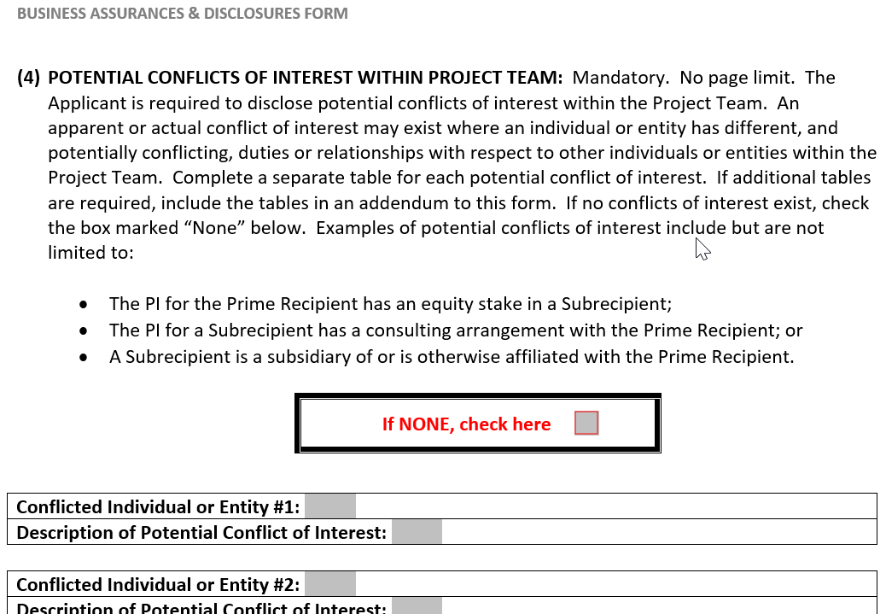
SAMPLE OCI CERTIFICATION
ARPA-E 340 Form –
Business Assurances & Disclosures Form

Slide 30
Poll Question
Have you seen OCI Certification forms from any of the following (chose all that apply):
DoD (including DARPA)
DOE (including ARPA-E)
NASA
NIH
NSF
Dept. of Education

Slide 31
OCI Certification FAQs
Who is covered by a University’s certification?
Only University personnel. Not independent consultants, subcontractors or subrecipients.
Who obtains certifications from Subs at time of PROPOSAL?
Follow Practice at your University: Submitting Department or Sponsored Research Office
Is FDP Clearinghouse Policy Sufficient for OCI?
No. FDP Clearinghouse is for policies on Individual COI, not Organizational COI.

Slide 32


Conclusions
Easier with practice
Be familiar with the types of COI
Good Proposal Prep (including subs)
= Successful OCI Review
Stakeholder education & involvement is KEY
Welcome to the COI network!

